Slide 1
Characterization of mutational processes affecting metastatic transformation in melanoma and the impact on therapy effectiveness
Doan Trang Laura Vo Ngoc
23 August, 2018
Notes:
Fix abbreviations

Slide 2
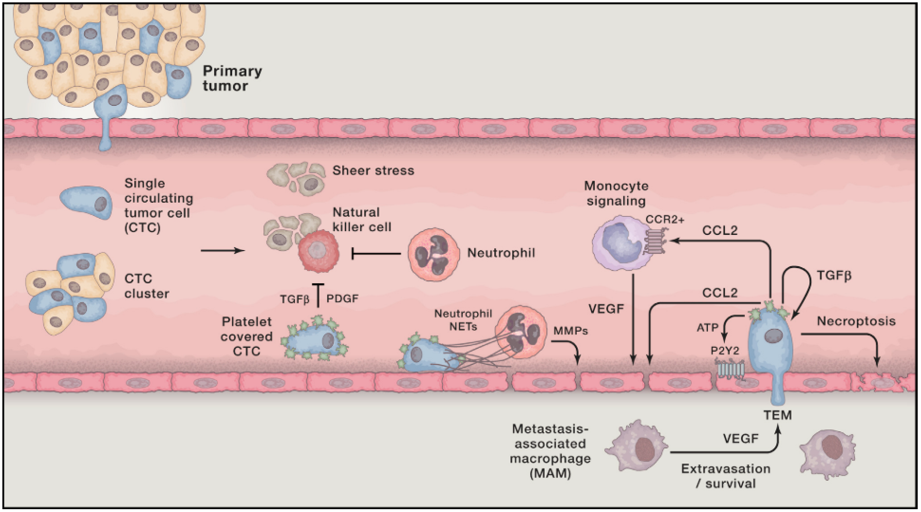
Metastasis
Leading cause of death
Seeding from primary tumor
Immune recruitment and metastatic niche formation
Colonization
(Lambert, 2017)
Notes:
Make pic bigger, make sure don’t lose res
Ref under pic (see notes)
Mb subset it
Make it slide-size and label it

Slide 3
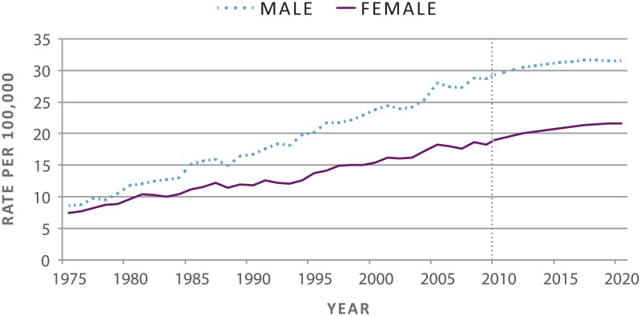
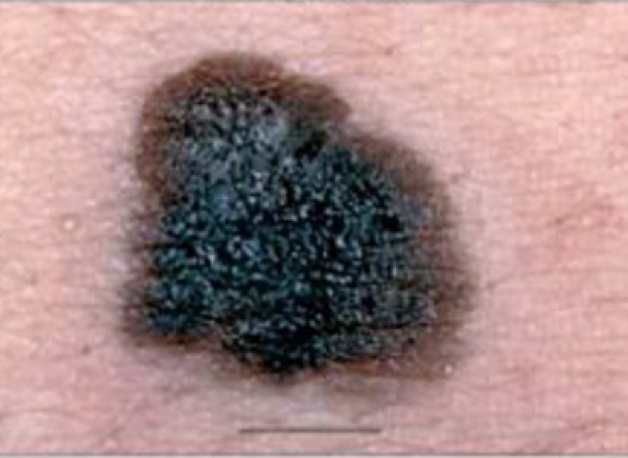
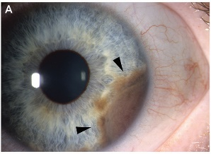
Melanoma
Rising incidence
Subtypes
Acral, mucosal, uveal, cutaneous
5-year survival
Primary: 99%
Metastatic: 49%
Pathways involved in:
Cell growth
Survival
Proliferation
Cutaneous
Uveal
(US Department of Health and Human Services, 2014; Arrangoiz et al., 2016)
Notes:
Shift pics more to the left
Put ref on the slide to fill empty space

Slide 4
Melanoma
Rising incidence
Subtypes
Acral, mucosal, uveal, cutaneous
5-year survival
Primary: 99%
Metastatic: 49%
Pathways involved in:
Cell growth
Survival
Proliferation
Therapies
Surgery
Chemotherapy
Radiotherapy
Targeted therapies
Immune-checkpoint therapies
(Lo and Fisher, 2014)
Notes:
Can even spend less time on thers

Slide 5
Melanoma risk factors
Notes:
Sth more visual:
risk factors for melanoma mainly uv, etc
Induces mutations in genome
(words or schematic)
Mutations specific and recognizable

Slide 6
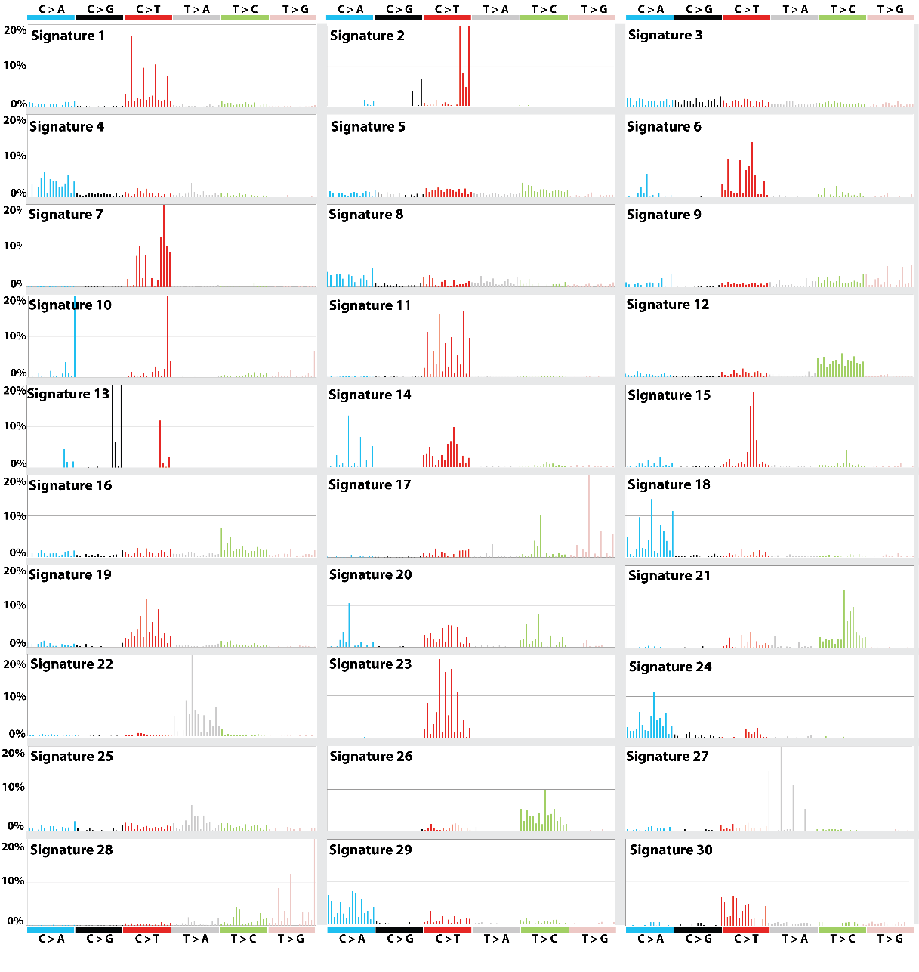
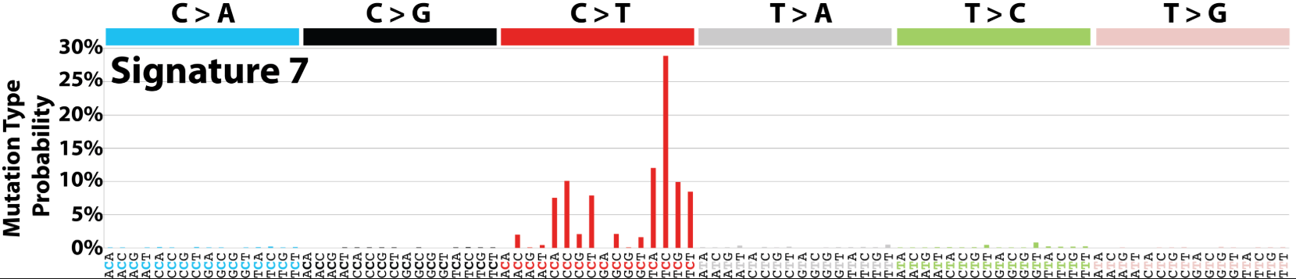
Mutational signatures
Context-specific somatic mutations
Two adjacent bases are important
Example: T[C]C > T[T]C
Associated to risk factors
COSMIC https://cancer.sanger.ac.uk/cosmic/signatures
UV LIGHT EXPOSURE
(Forbes et al., 2018)
Notes:
Need slightly better explanation
Can put a sun :D
Add before COSMIC: NMF or similar methods
Needs a prev slides

Slide 7
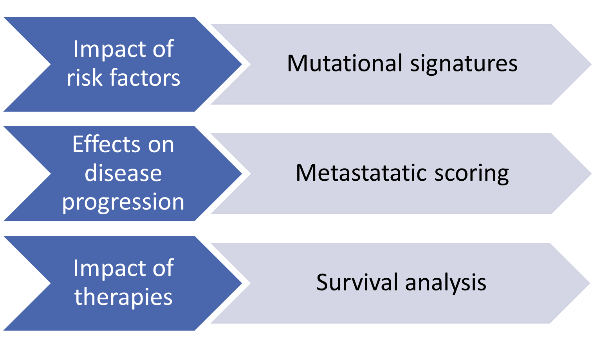
Aims & methods overview

Slide 8



Methods
The Cancer Genome Atlas (TCGA)
Whole exome sequencing
Clinical data
Gene expression data
Two cohorts
Skin cutaneous melanoma (SKCM)
Uveal melanoma (UVM)
Validation dataset – International Cancer Genome Consortium (ICGC)
Whole genome sequencing
Two cohorts
Australian melanoma (MELA-AU)
Brazilian skin adenocarcinoma (SKCA-BR)
Analyzed using R packages specific for these data
Notes:
Number of samples for each cohorts
Bigger fonts
Mb remove last point
Highlight that abbreviations will be used

Slide 9
Results

Slide 10
Mutational signatures

Slide 11
Top 5 contributors
Sample | Signatures | Etiology
SKCM | S7 | UV light exposure
 | S1 | Aging
 | S11 | Alkylating agents
 | S23 | Unknown; strong transcriptional strand bias
 | S6 | Defective DNA mismatch repair
UVM | S1 | Aging
 | S22 | Aristolochic acid
 | S15 | Defective DNA mismatch repair
 | S3 | DNA double-strand break repair failure
 | S6 | Defective DNA mismatch repair

Slide 12
Metastatic scoring
$$\text{Metastatic} \text{potential} \text{score}= \frac{\text{Avg} \text{expression} \text{upregulated} \text{genes}}{\text{Avg} \text{expression} \text{downregulated} \text{genes}}$$
Notes:
Add the flowchart
Put the genelist, or at least some example genes

Slide 13
METASTATIC SCORING
Notes:
Also explain what cancer stage
More advanced the cancer is, the higher the stage

Slide 14
Metastatic score correlates (primary SKCM)
Signature 1
Correlation coefficient = 0.16
p = 0.10
Signature contributions
Signature 7
Correlation coefficient = 0.14
p = 0.17
Notes:
X not very informative
Rephrase “signature contributions” → signature prevalence alone
Then for braf: signature prev in genetic context

Slide 15
Notes:
Slide with BRAF as a gene
Look for braf inhibition image
Title: braf driver of melanoma
Mut in % of patients
Braf inhibitors are strat in clinic that later cause resistance

Slide 16
Metastatic score correlates (primary SKCM)
Signature 1
Correlation coefficient = 0.43
p = 0.03
Signature contributions
Signatures 1 and 7 in BRAF WT
Signature 7
Correlation coefficient = 0.46
p = 0.02

Slide 17
Metastatic score correlates (primary SKCM)
Signature 1
Correlation coefficient = 0.41
p = 0.82
Signature contributions
Signatures 1 and 7 in BRAF WT
Signatures in BRAF mutant
Signature 7
Correlation coefficient = 0.11
p = 0.57
Notes:
Sig prev…. (BRAF WT)
( BRAF mutant)

Slide 18
Notes:
Introduce schwann cells
Pic of neurons and say tend to infiltrate vasc tissue (ex: epith), shown to involve in metast dissemination
+ refs

Slide 19
Metastatic score correlates (all samples)
Signature contributions
Signatures 1 and 7 in BRAF WT
Signatures in BRAF mutant
Schwann cell marker genes expression
Primary SKCM
Correlation coefficient = 0.26
p = 0.05
Metastatic SKCM
Correlation coefficient = 0.13
p = 0.002
Primary UVM
Correlation coefficient = 0.19
p = 0.04
Notes:
Replace primary and metastic for TP and TM
Abbreviations …
Mention that we took rnaseq data from tcga to analyze expr

Slide 20
Notes:
Try to squeeze in the cutoff figure
Where do we draw cutoff in early/late potential, based on distribution then show fig
Then lead to next slide

Slide 21
Metastatic potential vs. survival
Primary UVM
PRIMARY SKCM
Notes:
remove

Slide 22
Univariate survival models
Primary SKCM
METASTATIC SKCM
Notes:
Remove?
Maybe keep to set into survival mode…
Skip TM one

Slide 23
Notes:
Why we look at survival and sigs
Signature -> earlier metast -> diff response to treatment -> survival

Slide 24
Multivariate survival models
+ risk of death
Improved survival
Not statistically significant
Risk of death
Notes:
Cutaneous (TCGA)
Shows impact of each of these parameter on risk of death
Motivate why we looked at signatures as well
- Risk factors may sensitize cells to therapies differently and thus impact outcome

Slide 25
NER / MMR
Nuclotide excision repair (NER) | Mismatch repair (MMR) | Others with transcriptional strand bias
S4 | S6 | S2
S7 | S15 | S5
S11 | S20 | S12
S22 | S26 | S23
S24 |  | S27
S25
Marker genes expression
Correlates with metastatic potential score
Few correlations with signatures in TCGA cohorts
Notes:
Put the pathways on either sides (NER/MMR)
Text didn’t make much sense
Genes in ner/mmr pathways (ex genes) correlate with metpot
Remove the sigs corr line
Further arg/power for involvement of ner/mmr pathways in metast progression

Slide 26
Survival models in combined cohort
Disease progression
Cohort
Notes:
Remove, don’t mention

Slide 27
Survival models in combined cohort
TREATMENT
Notes:
Better highlight the legend
Mb highlight and draw arrows to “better outcome”

Slide 28
With treatment
+ risk of death
Improved survival
Not statistically significant
Risk of death
Notes:
Better title
Put with/without treatment in bold on the plot
Check model without cohort
Dna mismatch repair under S6

Slide 29
Without treatment
+ risk of death
Improved survival
Not statistically significant
Risk of death
Notes:
Better titles

Slide 30
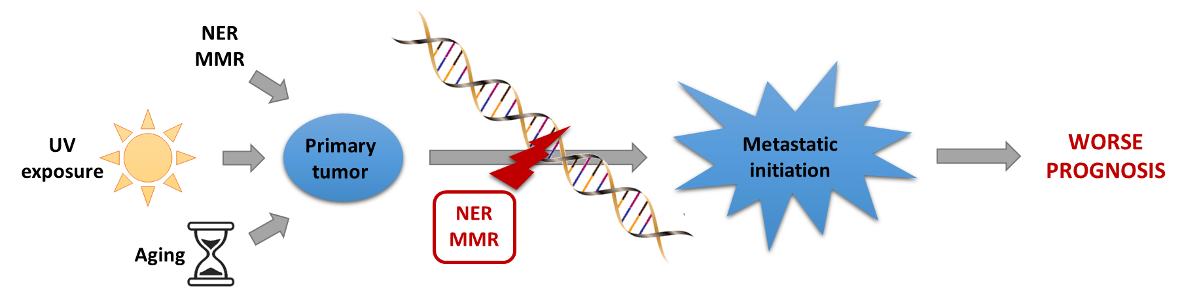
Conclusion
Notes:
Didn’t find effect of UV light on metast prog, except in absence of BRAF
Under NER/MMR – uv light + BRAF WT
Add summary statement (1 sentence under figure)

Slide 31
Some limitations
TCGA limitations
Small sample size
Lack of matched samples
No matched control data
Non-uniform and missing clinical annotations
Whole exome sequencing
ICGC lack of expression data
TCGA and ICGC data differences (WES vs. WGS)
Impact signature profiles
Notes:
Explain what matched samples mean
Or just say lack of prim and metast sample from the same samples
Explain why it matters that we’re not capturing whole genome (WES)
Increase font and fix color (make it darker)

Slide 32
Future research
Replication in larger cohorts
Better clinical data annotation
Uniformalized data acquisition methods
More complete survival annotation
Metastatic scoring in SKCM with more specific marker genes
Comparison with new mutational signatures (Alexandrov et al., 2018)
Chromosomal instability
Comparison with cancer in other tissues
Notes:
Put a picture of the current S7 vs the S7a b c

Slide 33
Notes:
Thank you slide

Slide 34
References
Alexandrov LB, Nik-Zainal S, Wedge DC, et al. Signatures of mutational processes in human cancer. Nature. 2013;500(7463):415-421.
Arrangoiz R. Melanoma Review: Epidemiology, Risk Factors, Diagnosis and Staging. J Cancer Treat Res. 2016;4(1):1.
Forbes SA, Bindal N, Bamford S, et al. COSMIC : mining complete cancer genomes in the Catalogue of Somatic Mutations in Cancer. 2018;39(October 2010):945-950.
Lambert AW, Pattabiraman DR, Weinberg RA. Emerging Biological Principles of Metastasis. Cell. 2017;168(4):670-691.
Lo, J.A., Fisher, D.E., 2014. The melanoma revolution: From UV carcinogenesis to a new era in therapeutics. Science (80-. ). 346, 945–949. https://doi.org/10.1126/science.1253735
Sandru A, Voinea S, Panaitescu E, Blidaru A. Survival rates of patients with metastatic malignant melanoma. J Med Life. 2014;7(4):572-576.
US Department of Health and Human Services, 2014. Figure 3, Age-Adjusted Melanoma Incidence Rates, Actual and Projected, by Sex, 1975–2020, in: The Surgeon General’s Call to Action to Prevent Skin Cancer. Office of the Surgeon General (US), Washington (DC).

